Slide 1
Pseudocode and Python
BIOINF 575
Study Session - SOLUTION

Slide 2
EXERCISE 1.1:
Motif find
Write pseudocode to find the sequence “AAC” in a given sequence.
e.g.: sequence = TCGAATACGGGAT, found = FALSE
e.g.: sequence = AATTGGTCGAACGA, found = TRUE
Walk through the code to see how the variables change

Slide 3
Motif check Pseudocode SOLUTION:
__________________
Set input parameters:
LET sequence = "TCGAACACGGGAT"
LET search_text = "AAC"
LET current_position = 1
LET found = FALSE
REPEAT
LET current_text = sequence[current_position to current_position + 2]
IF current_text IS EQUAL TO search_text THEN
found = TRUE
EXIT REPEAT
current_position = current_position + 1
UNTIL current_position > sequence length - 2
DISPLAY found
_____________________
Walk through the code:
REPEAT STEP: 1 2 3 4
current_position = 1 2 3 4
found = FALSE [not changed] TRUE
current_text = TCG CGA GAA AAC

Slide 4
EXERCISE 1.2:
Ask a GenAI tool to write the python code for Exercise 1.1.
Ask it to explain the code.
e.g.: sequence = TCGAATACGGGAT, index = -1
e.g.: sequence = AATTGGTCGAACGA, index = 10

Slide 5
The code can be very simple, use the in operator to check if the motif is in the sequence
Write this code in a motif_find.py file
Run the file using python motif_find.py
You can also write the code in a code cell in python notebook and run the code
You can also keep only the first three lines (the function) in a check_pattern.py file/module and then import that (import check_pattern) in another file/script run_function.py that also contains the rest of the code (the if statement)
Running the run_function script (python run_function.py) will import the function from the module and compute and return the result
sequence = "TCGAATACGGGAT"
print(f"Does the {sequence} contain 'AAC’?”)
print("Answer:", "AAC" in sequence)

Slide 6
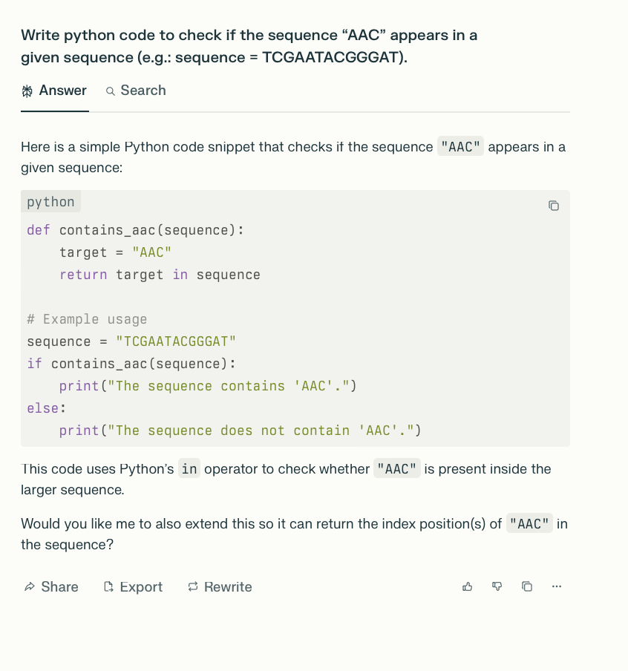
If you ask Gen AI it will create a function that sets a variable target to the text to search for “AAC”. Then, it uses the in operator with the sequence and the target to check if the target is in the sequence and get a True/False result.
It then calls that function with a given sequence and gets the result which it prints to the screen.

Slide 7
Write this code in a motif_find.py file
Run the file using python motif_find.py
You can also write the code in a code cell in python notebook and run the code
You can also keep only the first three lines (the function) in a check_pattern.py file/module and then import that (import check_pattern) in another file/script run_function.py that also contains the rest of the code (the if statement)
Running the run_function script (python run_function.py) will import the function from the module and compute and return the result
def contains_aac(sequence):
target = "AAC"
return target in sequence
# Example usage
sequence = "TCGAATACGGGAT"
if contains_aac(sequence):
print("The sequence contains 'AAC'.")
else:
print("The sequence does not contain 'AAC'.")

Slide 8
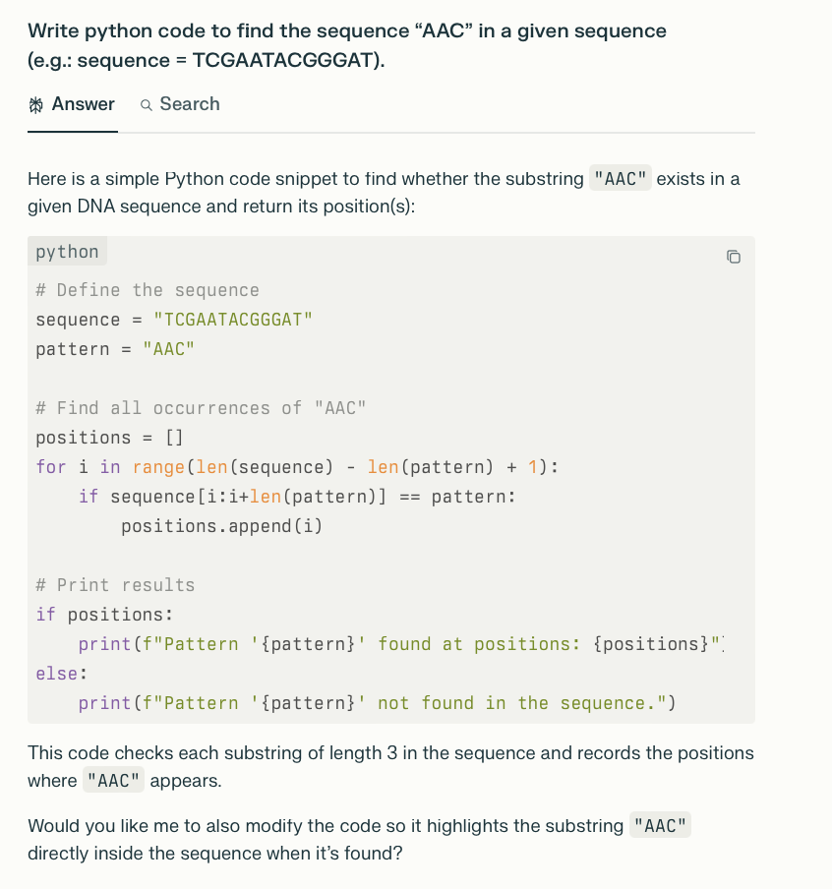
If you ask Gen AI and are not specific enough, you get an algorithm that looks for AAC starting at every position in the sequence, checks every three nucleotides and finds all the indices (0-based) where the codon AAC starts.

Slide 9
Write this code in a motif_find_indices.py file
Run the file using python motif_find_indices.py
You can also write the code in a code cell in python notebook and run the code
# Define the sequence
sequence = "TCGAATACGGGAT"
pattern = "AAC"
# Find all occurrences of "AAC"
positions = []
for i in range(len(sequence) - len(pattern) + 1):
if sequence[i:i+len(pattern)] == pattern:
positions.append(i)
# Print results
if positions:
print(f"Pattern '{pattern}' found at positions: {positions}")
else:
print(f"Pattern '{pattern}' not found in the sequence.")

Slide 10
EXERCISE 1.2:
See if you can change the python code that checks for the presence of the motif to find the position where the first occurrence of the the sequence “AAC” in a given sequence.
– indices start from 0 in python so add 1 to get the position
– There are string function that already implement the functionality we need in python
https://docs.python.org/3/library/stdtypes.html#string-methods
Note: look at the .find and .index functions
e.g.: sequence = TCGAATACGGGAT, index = 0 # 0 if not found
e.g.: sequence = AATTGGTCGAACGA, index = 10

Slide 11
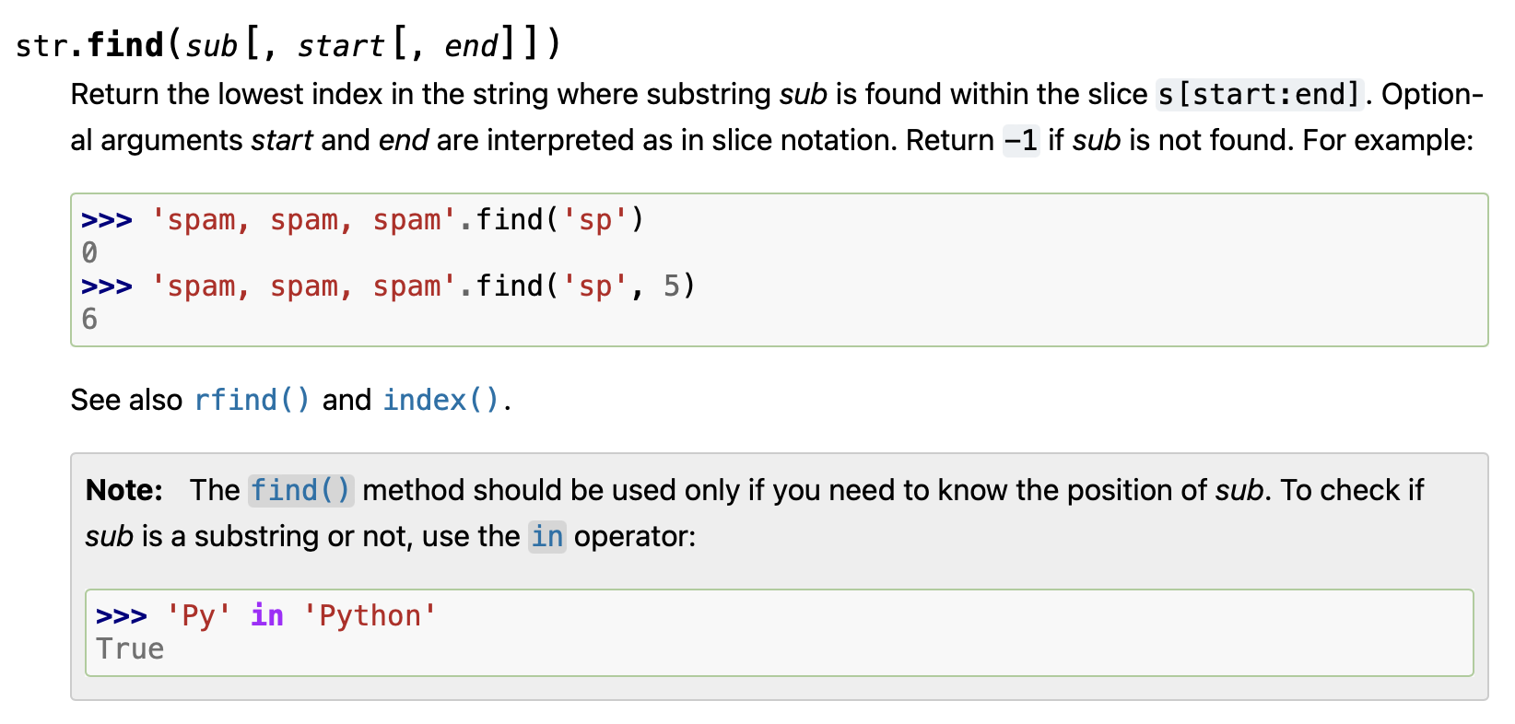

The code to return the position of the first occurrence of the motif in the sequence would be simple
There are string function that already implement the functionality we need in python
https://docs.python.org/3/library/stdtypes.html#string-methods
Note: look at the .find and .index functions that both return that result, the difference is index gives an error when not found and find returns -1
Write this code in a motif_find_pos.py file
Run the file using python motif_find_pos.py
You can also write the code in a code cell in python notebook and run the code
# Define the sequence
sequence = " AATTGGTCGAACGA"
pattern = "AAC"
# Return the index of a pattern in a sequence
# returns -1 if the pattern is not found
pos = sequence.find(pattern) +1
print(pos)

Slide 12
EXERCISE 2.1:
Pattern Search
Write pseudocode for an algorithm that finds the start index for all occurrences of a custom pattern (e.g.: AAC) in your sequence, the result will be a list of indices where the pattern occurs in your sequence
e.g.: sequence = TCGAATACGGGAT, indices = []
e.g.: sequence = AATTGGTCGAACGAAACTT, indices = [9,14]
Walk through the code to see how the variables change

Slide 13
Pattern design: TATA
I've chosen the pattern "TATA" as my custom pattern. This is inspired by the TATA box, which is a common DNA sequence in promoter regions of genes in eukaryotes. The TATA box is typically found about 25-35 base pairs upstream of the transcription start site and plays a crucial role in the initiation of gene transcription. It serves as a binding site for transcription factors, helping to position RNA polymerase II correctly at the start of a gene.

Slide 14
Pattern Search Pseudocode SOLUTION:
__________________
SET sequence TO "ATATACGTAGCTATAGCTAGCTATAAGC"
SET pattern TO "TATA"
SET occurrences TO empty list
FOR i FROM 0 TO LENGTH(sequence) - LENGTH(pattern)
DO
IF sequence[i to i+LENGTH(pattern)-1] EQUALS pattern THEN
APPEND i TO occurrences
ENDIF
ENDFOR
DISPLAY "Pattern occurrences at indices:", occurrences
__________________
Numerical walkthrough:
Input: ATATACGTAGCTATAGCTAGCTATAAGC
Step 1: Initialize variables (pattern = "TATA", occurrences = [])
Step 2: Iterate through the sequence
i = 0: "ATAT" ≠ "TATA"
i = 1: "TATA" = "TATA" -> occurrences =
i = 2: "ATAC" ≠ "TATA"
...
i = 13: "TATA" = "TATA" -> occurrences = [1, 13]
...
i = 23: "TATA" = "TATA" -> occurrences = [1, 13, 23]
...
i = 24: "TAAG" ≠ "TATA"
Final result:
Pattern occurrences at indices: [1, 13, 23]

Slide 15
EXERCISE 2.2:
Complementary Sequence
- Write pseudocode for an algorithm that generates the complementary strand of your DNA sequence
- Remember: A pairs with T, C pairs with G
e.g.: sequence = TCGAA, complement = AGCTT
e.g.: sequence = AATTGGC, complement = TTAACCG
Walk through the code to see how the variables change

Slide 16
Complementary Sequence Pseudocode SOLUTION:
__________________
SET complementary TO empty string
FOR i FROM 0 TO LENGTH(sequence) - 1
DO
CASE sequence[i] OF
'A': APPEND 'T' TO complementary
'T': APPEND 'A' TO complementary
'C': APPEND 'G' TO complementary
'G': APPEND 'C' TO complementary
ENDCASE
ENDFOR
DISPLAY "Complementary sequence:", complementary
__________________
Numerical walkthrough:
Input: ATATACGTAGCTATAGCTAGCTATAAGC
Step 1: Initialize complementary as an empty string
Step 2: Iterate through the sequence
i = 0: 'A' -> complementary = "T"
i = 1: 'T' -> complementary = "TA"
i = 2: 'A' -> complementary = "TAT"
i = 3: 'T' -> complementary = "TATA"
i = 4: 'A' -> complementary = "TATAT"
i = 5: 'C' -> complementary = "TATATG"
...
i = 27: 'C' -> complementary = "TATATGCATCGATATCGATCGATATTCG"
Final result:
Complementary sequence: TATATGCATCGATATCGATCGATATTCG

Slide 17
EXERCISE 3.1:
Write bash code to identify the top 5 most common food groups (food_group column) in the Food.csv. Check the header the see what columns are available in the file.
- The result would be 5 lines with 2 columns: count and food group name
Notes:
- The file is comma separated, but it has some fields that have commas in the text, for instance, the food description text is quoted and contains commas and sometimes new lines and quoted text.
An example description with commas:
"Angelica is a genus of about 60 species of tall biennial and perennial herbs in the family Apiaceae, native to temperate and subarctic regions of the Northern Hemisphere, reaching as far north as Iceland and Lapland. They grow to 1–3 m tall, with large bipinnate leaves and large compound umbels of white or greenish-white flowers. Some species can be found in purple moor and rush pastures."

Slide 18
Include the command and the result (food group name and count) in the solution file.
COMMAND:
tr "\n" "~" < Food.csv |sed 's/"[^"]*"//g' | tr "~" "\n" | cut -d, -f12 | sort | uniq -c | sort -nr | head -n5
# the tr command replaces the new lines (\n) with tilda (~)
# replacing the new line makes descriptions that span multiple lines to have the quotes on the same line
# this helps with commands the process the file line by line like grep, sed, awk
# sed 's/"[^"]*"//g' replaces/substitutes (s) generally (g - all occurrences of the pattern in a line)
# the pattern is replaces with nothing (//)
# the pattern:"[^"]*" matches two double quotes with anything in between but a double quote
# the cut command breaks each line by the delimiter (-d,) which we set to , by using the -d option
# the -f option for cut retrieves the respective field/column - in this case column 12 - the food group name
# columns are separated by the delimiter from -d or tab if no delimiter is provided
# the sort command sorts the lines lexicographically
# the uniq command provide the unique elements/lines in a file,
# -c option for uniq counts how many consecutive lines with each element there are
# the -n option for sort orders data numerically
# the -r option for sort orders data in reverse (high to low counts in this case)
# the head command provides the top 10 lines in the input
# the -n option for the head command retrieves the given number of lines, in this case 5
RESULT:
169 Aquatic foods
157 Fruits
147 Vegetables
126 Herbs and Spices
51 Dishes

Slide 19
EXERCISE 3.2:
Ask a Gen AI tool to write python code to solve Exercise 3.1.
Is it simpler to write python code for this exercise than solving the exercise in bash?
Note: The compound name may contain commas and in that case is quoted - that affects the split by comma but should not affect the results in this case

Slide 20
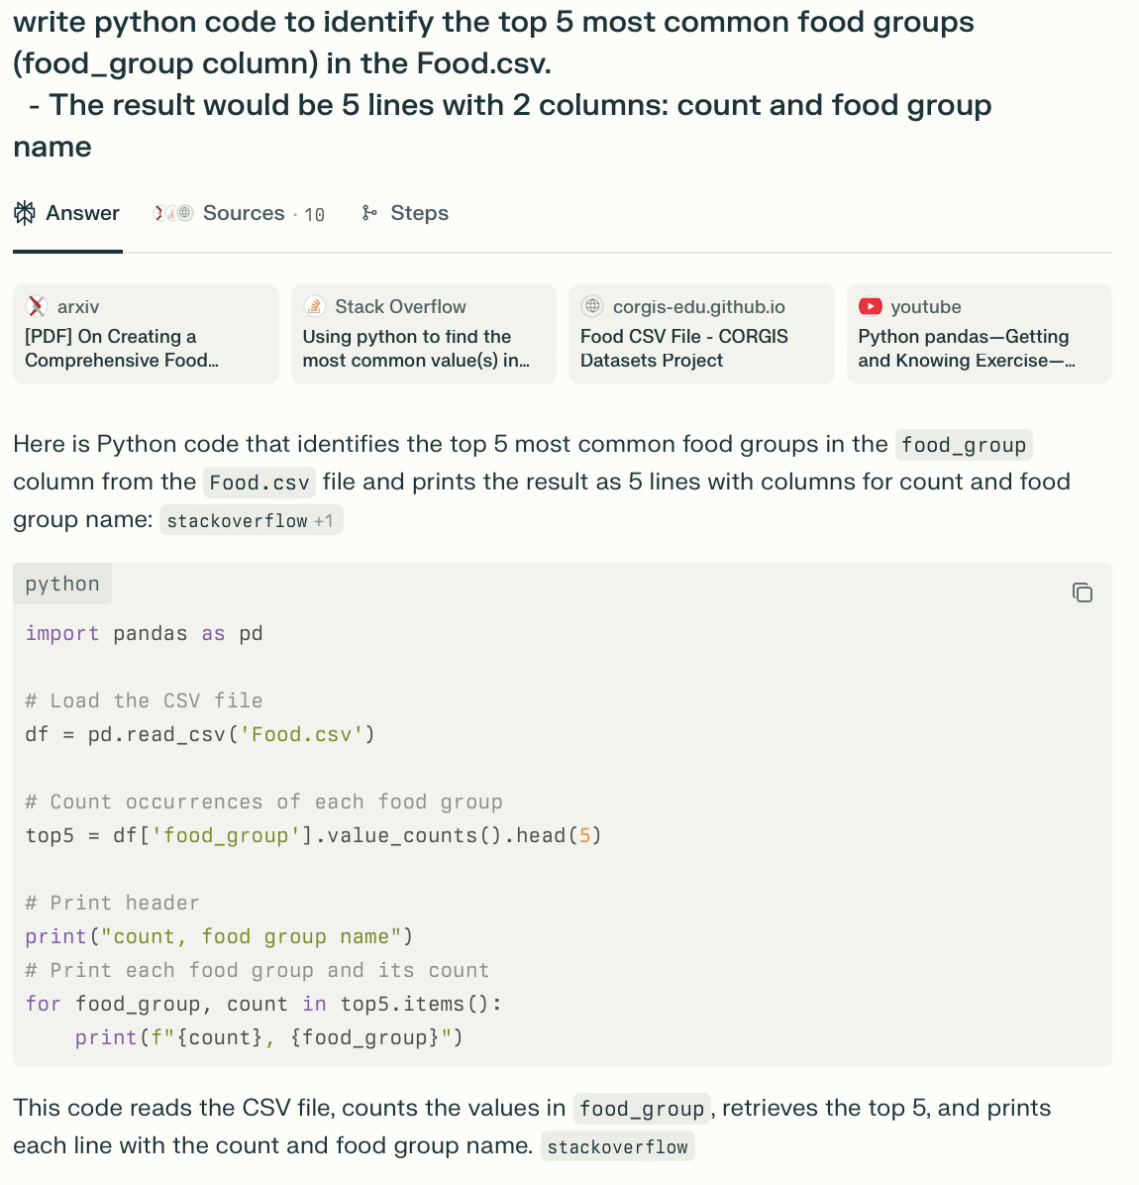
If you ask Gen AI it will provide good code that makes use of relevant libraries for loading .csv files and processing matrix data. It then does a summary of unique values (.value_counts()) and takes only the top 5 (head).
It then goes through those values and displays them.
The for loop is not really needed, printing top5 it will still do a good job of displaying the results.
Python handles the quotes much better and recognizes when a separator (the comma, “,”, in this case is part of the text in a column rather than being the column separator, which bash does not do.
In two simple lines of code python does what the complex series of commands in bash do.

Slide 21
Write this code in a top_food_groups.py file
Run the file using python top_food_groups.py
You can also write the code in a code cell in python notebook and run the code
import pandas as pd
# Load the CSV file
df = pd.read_csv('Food.csv')
# Count occurrences of each food group
top5 = df['food_group'].value_counts().head(5)
# Print header
print("count, food group name")
# Print each food group and its count
for food_group, count in top5.items():
print(f"{count}, {food_group}")

Slide 22
Resources:
https://www.unf.edu/~broggio/cop2221/2221pseu.htm
https://users.csc.calpoly.edu/~jdalbey/SWE/pdl_std.html
https://git-scm.com/docs/gittutorial
https://try.github.io
https://www.tutorialspoint.com/git/index.htm
https://www.atlassian.com/git/tutorials/using-branches/merge-conflicts

